Slide 1
Blind’s Eye : IoT based real-time surrounding identification
and object detection
^{HIMANSHU SHEKHAR} ENROLMENT NO. : 12017002002067 ^{SUJOY SEAL} ENROLMENT NO. : 12017002002010
^{Under the supervision of} PROF. TUFAN SAHA Department of Computer Science and Engineering Institute of Engineering and Management

Slide 2
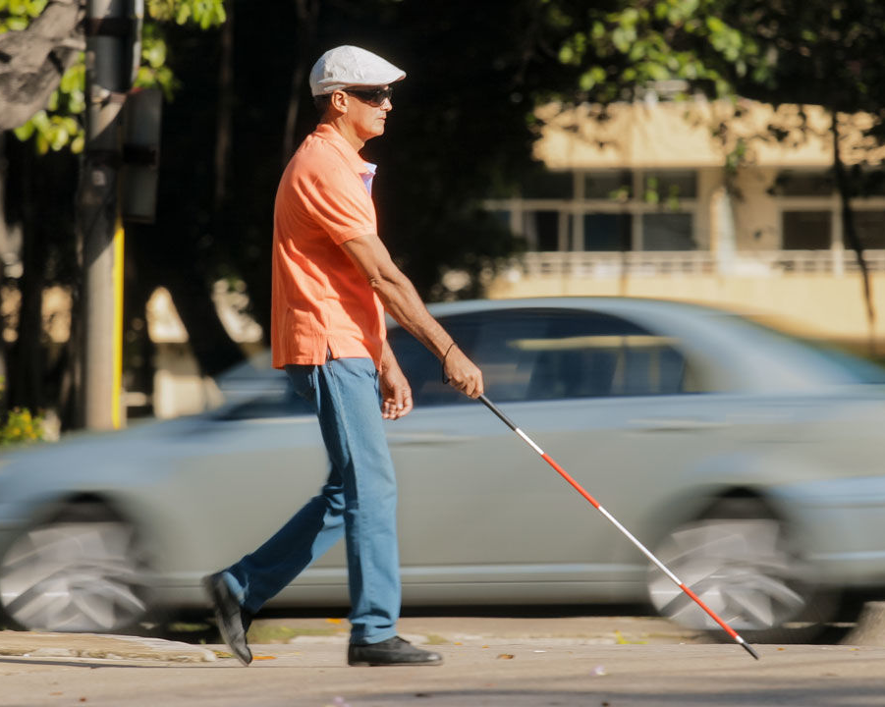
PROBLEM
There are 285 million people in the world who are visually impaired of whom 39 million are blind ⁽²⁾. These people can not do most useful jobs in human life like walking, crossing roads, roaming around their own house, etc. without the help of someone else, which they can do if they get some necessary information.
Fig. 1. A visually impaired person crossing street ⁽¹⁾

Slide 3
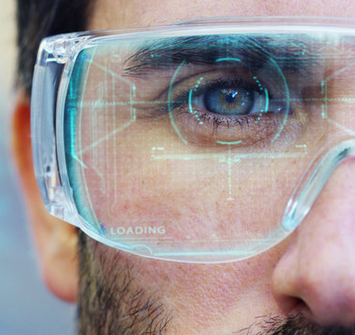
INTRODUCTION
If we provide necessary information in real time to the user then he can take immediate necessary steps in that circumstances like normal human beings, for example, if the user is crossing a road and he gets the information that a car is approaching to him with 40 miles per hour, he can either move left or right to save himself.
Fig. 2. A man with a futuristic look with glasses
augmented reality in holography. ⁽³⁾

Slide 4
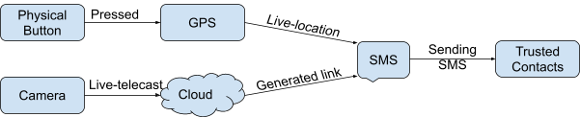
PROCESS
Fig. 3. A block diagram showing the process for providing surrounding information to the user.

Slide 5
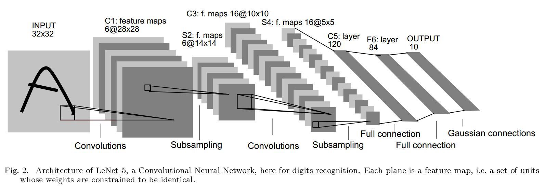
ARCHITECTURE
4.
(4)

Slide 6
CODE
#Extracting features to detect objects
blob=cv2.dnn.blobFromImage(img,0.00392,(416,416),(0,0,0),True,crop=False)
#Inverting blue with red
#bgr->rgb #We need to pass the img_blob to the algorithm
net.setInput(blob)
outs=net.forward(output_layers)
#print(outs)

Slide 7
SECURITY
Fig. 5. A block diagram depicting security aspect imbedded in the device

Slide 8
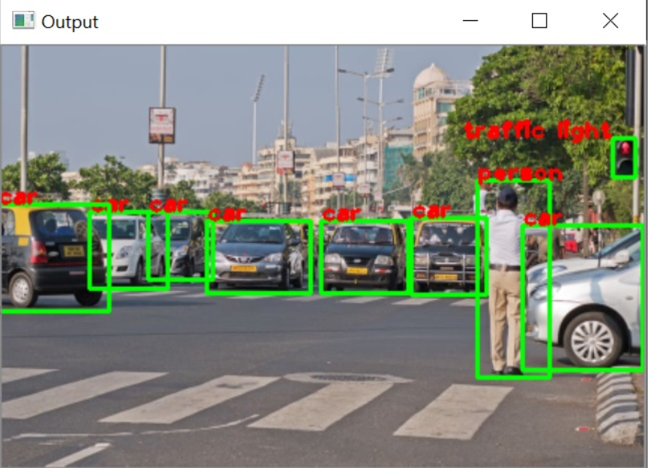
OUTPUT
Fig. 6. Intermediary output of the model

Slide 9
STATUS
Need to implement hardware for making system portable.
Plan of Action : Raspberry Pi 3 with Raspbian or Noobs.
Need to implement for a varied dataset
Plan of Action : Gather More dataset.
Use of CNN with more neurons instead of Open CV
Plan of Action : Modify existing Algorithm

Slide 10
REFERENCES
Servick K. Echolocation in blind people reveals the brain’s adaptive powers. Science Mag. (Oct. 1, 2019). https://www.sciencemag.org/news/2019/10/echolocation-blind-people-reveals-brain-s-adaptive-powers. [Last accessed on: Jun. 5, 2021]
Pascolini D, Mariotti SPM. Global estimates of visual impairment: 2010. British Journal Ophthalmology Online First published December 1, 2011 as 10.1136/bjophthalmol-2011-300539.
HQUALITY. A man with a futuristic look with glasses augmented reality in holography. Adobe Stock. (n.d.). FILE #: 145565083. https://stock.adobe.com/in/search?k=futuristic+glasses. [Last accessed on: Jun. 5, 2021]
LeCun Y. Convolutional neural network from lenet to DPN development. ProgrammerSought. (n.d.). https://www.programmersought.com/article/14632343240/. [Last accessed on: Jun. 5, 2021]

Slide 11
THANK YOU !

